Slide 1
EAI, B2B and Integration Challenges
Praveen Kumar
Computer Science and Engineering
Ohio State University
Notes:
Welcome to the lecture on service integration using messaging. The goal for this lecture is to learn how applications can integrate asynchronously by sending and receiving messages.

Slide 2
Agenda
JSON Web Tokens (JWT)
Enterprise Application Integration (EAI)
Batch Applications
Summary
API Security
API Gateways
Business to Business (B2B) Computation

Slide 3
Application Integration (recap)
Application 1
RESTful APIs (HTTP)
Application 2
Messaging
doXYZ ()
Service Integration so far:
RESTful APIs
Messaging
Challenges
Integration code inside applications
Consumer (App1) needs to know location of Provider (App2)
Tight coupling, mixing of concerns

Slide 4
Solution?
Application 1
Int Tier
Int Tier
Application 2
Use “Integration Tier” on each side
Hide integration complexity
Abstract location & integration logic
Dependency injection, Hollywood pattern, etc.

Slide 5
... but what about the Enterprise?
Sales App
Int Tier
Int Tier
Enterprise Resource Planning App
What about security?
Customer Servicing App
Int Tier
Int Tier
Finance App
Point-to-Point
Many-to-Many
Int Tier
Inventory Management App
Notes:
But what about the enterprise?
Assume you have five applications in the Enterprise, all utilizing an appropriate middleware. What kind of interaction do they have?
<play the animation, until all arrows are visible>
That’s a lot of interaction! What else did you notice here? <pause> Every application is trying to figure out its own way to integrate with other applications. These integrations are point to point <hit enter> and <many to many <hit enter>.
Another big question – what about the security? How to make sure these various applications are “allowed” to access? Does that go inside the Integration Tier code as well?
There has GOT to be a better way!
There are many other challenges with this style of integration. Let’s discuss them first.

Slide 6
Enterprise Application Integration (EAI) Challenges
Common concerns for the applications
Protocol translation
Locating & routing
Authentication & access permissions
Operational complexity for the enterprise
Availability monitoring
Maintenance & co-ordination
Auditing & troubleshooting
Single point of failure
Point to Point integration does not scale!
Notes:
The application landscape in a real enterprise is heterogeneous. The applications, typically created over several years, utilize a wide range of technology platforms. With the point-to-point integration that you saw in the previous slide, each application will have to deal with certain computational concern on their own, locally. Some of the key concerns are:
Protocol translation
Locating and routing
Authentication and access permission.
The logic to deal with these concerns are duplicated and scattered across the Enterprise.
Apart from that, there are several operational needs in an Enterprise, which can become very complex to manage in a point-to-point integration architecture. Some of the key operational requirements are:
Availability monitoring
Corrective or Preventive maintenance on the applications, and the resulting co-ordination needs, because application needs to be off-line for some time
Auditing of key business activities and troubleshooting
Single point of failure for critical cross-functional business processes
BOTTOM LINE - The point-to-point integration solution does not scale.
There has got to be a better way!

Slide 7
Enterprise Middleware
Sales App
Customer Servicing App
Middleware
Inventory Management App
Enterprise Resource Planning App
Finance App

Slide 8
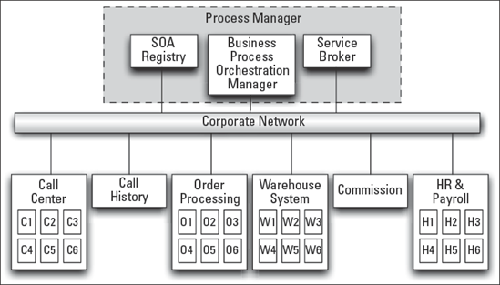
Traditional Middleware Solution: Enterprise Service Bus (ESB)
Business Services
ESB
Apps
Notes:
Shown in the diagram here is an enterprise, which has embraced a traditional middleware known as Enterprise Service Bus (ESB)
It has various applications that constitute functional areas: call center, order processing, warehouse, commissions, and HR & Payroll. The services provided by these applications interact with each other using an ESB which contains, along with other things, a process manager which has the ability to orchestrate business processes in terms of interacting services.

Slide 9
Enterprise Service Bus (ESB)
Core Capabilities
Issues & Challenges
Service invocation
Routing
Mediation
Messaging
Orchestration
Event Processing
Operations Mgmt.
Transformation
Security
Became too big, complex, heavyweight and expensive
Needed specialized skills, which led to centralized “ESB Team”
Too slow to adopt, and teams started to work around it

Slide 10
Modern Solutions
While ESBs were failing in the enterprises, two new techniques were evolving
(1) Microservices & APIs
(2) Event driven integration
Consequently, two new middleware emerged:
- API Gateway
- Event Broker

Slide 11
API Gateway
API Gateway
Monolith 1
API
Web Application
API
API
Mobile Application
API
Microservice 1
3rd party Application
Microservice 2
API
Relatively much lighter weight than traditional ESBs
Similar (to ESB) but limited core capabilities (security, routing, location transparency)
Notes:
API Gateway is such a middleware for use within an Enterprise for API based application integration.

Slide 12
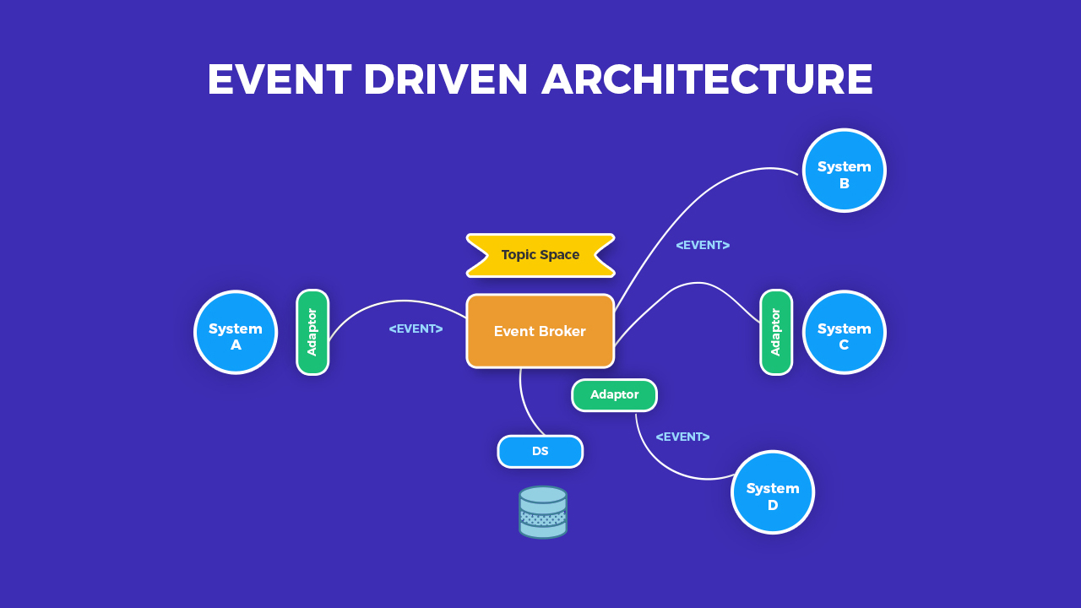
Event Broker / Event Service Bus
Image Credit: https://softobiz.com/understanding-the-event-driven-architecture/

Slide 13
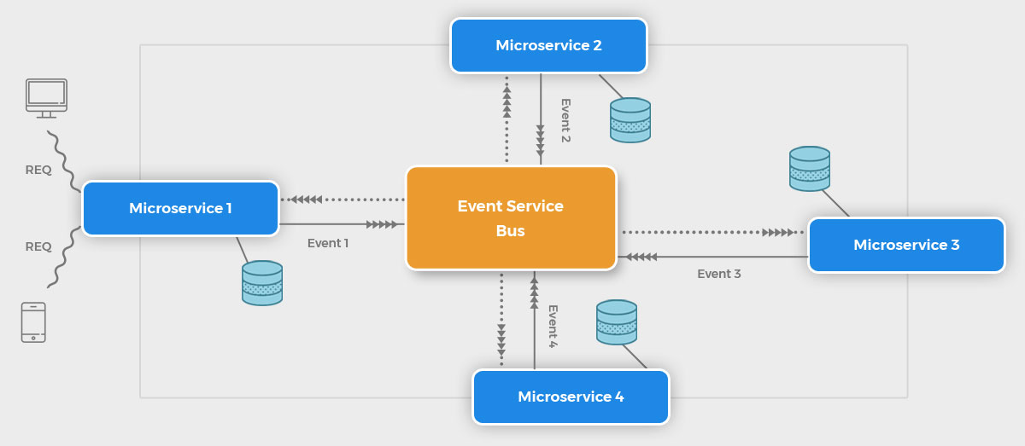
Reactive Microservices
Notes:
Event Brokers or Event Service Bus have given rise to another architecture style – called reactive microservices architecture. This is still evolving, but it is definitely the future.

Slide 14




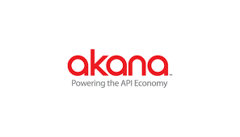


API Gateway Products
ApiGee
MuleSoft
Axway
Kong Inc.
Akana
TIBCO Mashery
Gloo
AWS API Gateway**

Slide 15
API Gateway – Core Capabilities
Category | Description
Security | Support for authentication and authorization
Routing & Location Transparency | Single point of entry. Routing of calls based on rules or policies. Connect to services across data centers and clouds without clients knowing about it
Rate Limiting | Shielding APIs from over-use and abuse
Orchestration | Handling scenario when a single request results in calls to multiple microservices
Monitoring & Alerting | Instrumentation for error detection and remediation
Analytics | Understanding usage patterns and monetization
Lifecycle management | Managing APIs through design, operation, and retirement

Slide 16
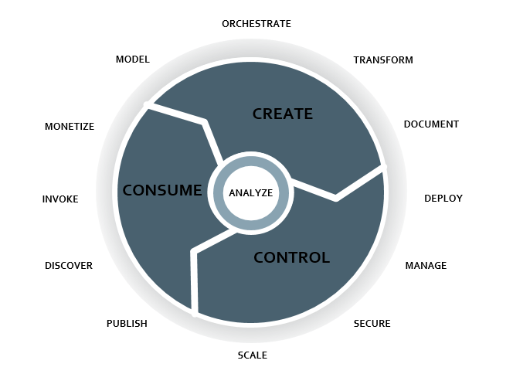
API Lifecycle Management
https://blog.axway.com/amplify-products/api-management/api-lifecycle-management
Notes:
APIs are key enablers of digital business.
The major challenge for companies is to cope with the increasing demand for new APIs by:
Creating APIs rapidly
Controlling them by managing a catalog and enforcing a powerful security level
Consuming them directly or via third-party developers
The API Lifecycle Management approach provides a holistic view of how to manage the different stages in the life of an API, from creation to retirement.
The API Lifecycle Management diagram represents a detailed view of the steps in the life of an API.

Slide 17
API Security
APIs are the new “face” of digital business, especially for partner companies
API security is about preventing or mitigating attacks
APIs work as backend for mobile & web apps, critical to protect the data they transfer
Rise of IoT makes API security paramount

Slide 18
API Security – Top 10 vulnerabilities
Broken Object Level Authorization
Broken User Authentication
Excessive Data Exposure
Lack of Resources & Rate Limiting
Broken Function Level Authorization
Mass Assignment
Security Misconfiguration
Injection
Improper Assets Management
Insufficient Logging & Monitoring
Source: https://owasp.org/www-project-api-security/

Slide 19
API Security – Best Practices
Vulnerabilities (detection & correction)
Security Tokens
Encryption
OAuth & OpenID Connect
Throttling & Quotas
Authentication on API Gateway
Zero-Trust Approach

Slide 20
JSON Web Token (JWT)
JWT (pronounced JOT) is an open standard that defines a way for securely transmitting information between parties as a JSON object
JWT contains signed “claims”
Information in JWT can be trusted because it is digitally signed

Slide 21
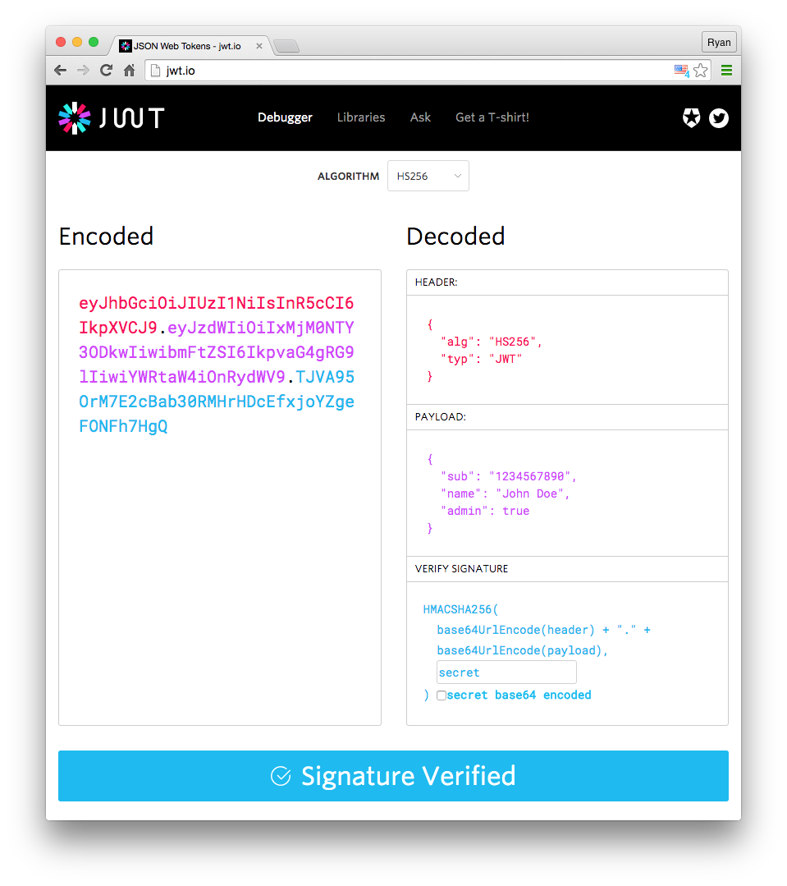
JWT (contd.)
JWT (contd.)
Header
Algorithm
Token type
Payload
Set of claims
Signature
Calculated from header, payload, and a secret

Slide 22
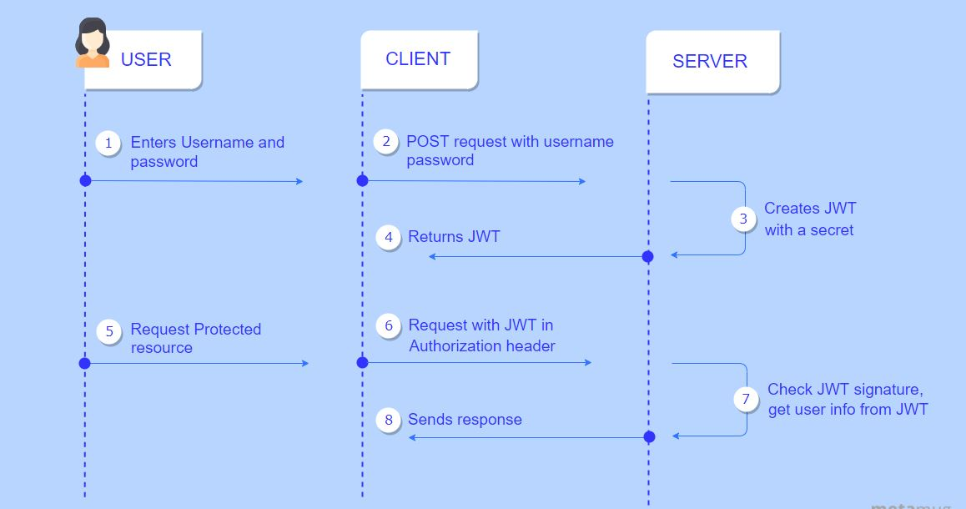
How does JWT Work?
Source: https://metamug.com/article/security/jwt-java-tutorial-create-verify.html

Slide 23
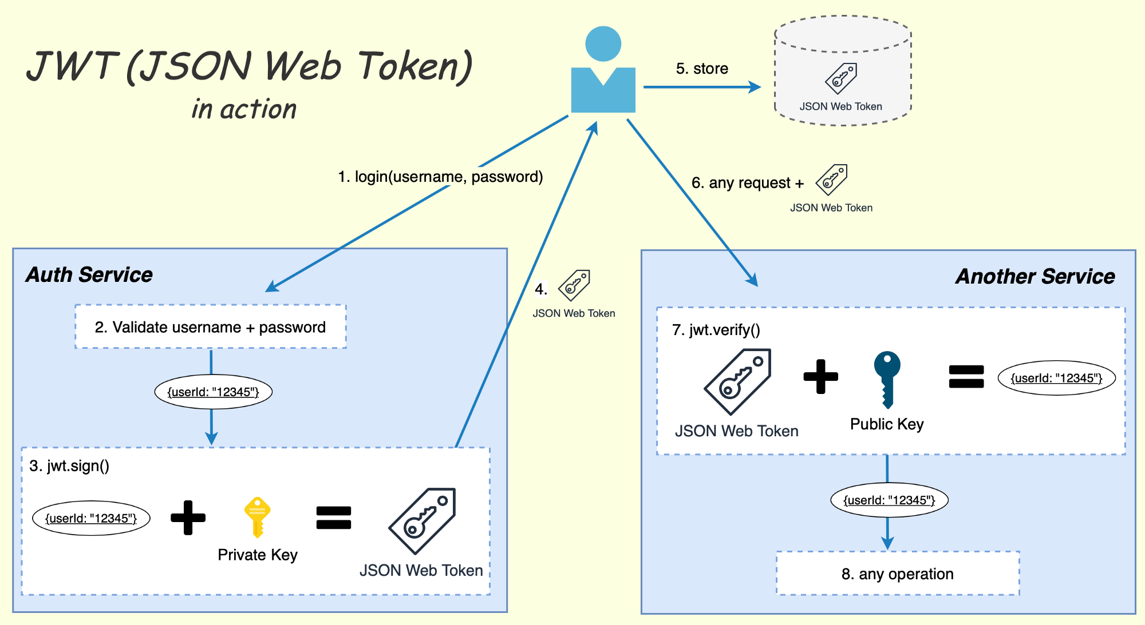
How does JWT work – contd.
Source: https://losikov.medium.com/part-6-authentication-with-jwt-json-web-token-ec78459b9c88
Notes:
An Enterprise typically uses API Gateway to implement Auth Service. All the APIs configured on this API Gateway honor the JWT issued by the gateway.

Slide 24
Business to Business (B2B)

Slide 25


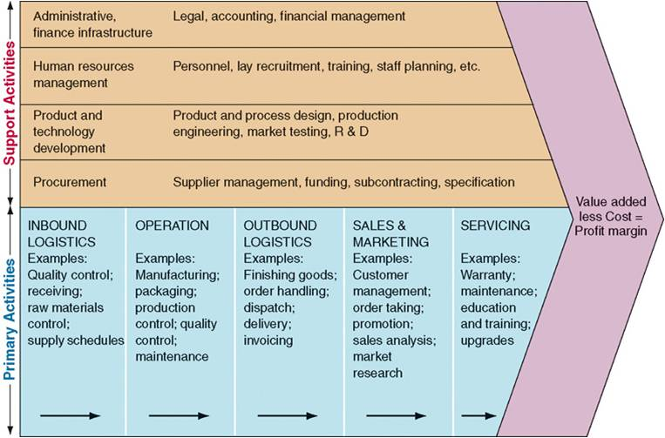


Extended Enterprise or B2B
Network of independent firms with specialized expertise, that collaborate to create an efficient value chain
Notes:
First, let’s understand what is an extended enterprise.
It is a network of independent firms with specialized expertise, that collaborate to create an efficient value chain.
Here is a diagram from the first lecture, which shows that value chains of Proctor & Gamble, Amazon, and UPS are inter-linked. P&G products are sold by amazon, and then shipped to customers by UPS, thus creating a value chain across enterprises.
Extended enterprise is also known as Business-to-Business or B2B.

Slide 26
Why Extended Enterprise?
Firms routinely outsource and sub-contract in order to focus on core competencies, relying on partner firms
Business processes can transcendent organizational boundaries
Certain businesses operate in industrial market only – no end users (e.g., raw material suppliers, secondary activities, etc.)
Notes:
Why Extended enterprise? You might ask.
Firstly, Firms routinely outsource and sub-contract in order to focus on core competencies. The marketplace typically forces firms to be very good at doing only a few things – which is known as their core competency. They rely on partner firms to complete the value chain for end customers.
Secondly, Business processes can transcendent organizational boundaries. For example, as you saw in case of Amazon, the sales business process requires a financial organization such as a bank, and a shipping organization, such as UPS; to interact with Amazon in a certain sequence, to complete the sales process for end customer.
And thirdly, certain businesses operate in industrial market only – they sell their products and services to other firms, and they do not have end customers. For example, building construction material supplier – must sell their products to home construction companies, and not to home owners. Similarly, firms that specialize in secondary activities in the value chain, may not interact with end customers. Take the example of a firm that specializes in recruiting and staffing. They must sell their services to other firms looking for new recruits.

Slide 27
Characteristics of B2B integration
Interaction through agreements or contracts
Interfaces designed for small & targeted audience (industrial market)
Quality of Service (QoS) requirements are high – timely, secure, and reliable exchange of information is critical
Highly customized interaction – time and cost efficiencies are important
Notes:
Certain key characteristics of Extended enterprise integration sets it apart from Enterprise Application Integration or EAI that you learned in the previous lecture.
The interaction across partner firms happen based on agreements or contracts.
Interfaces are designed for small & targeted audience, which is the industrial market. You typically have a small number of high volume, and high value transactions.
Quality of Service requirements are high – timely, secure, and reliable exchange of information is critical
And, the interaction is highly customized. That is because time and cost efficiencies are important. For example, suppose you have a sales portal for your partners. Now, you do not want your partner firm to browse through a catalog of products that they do not care about. You must customize, so that they can get in, get exactly the information that is relevant to them (including custom, negotiated price), do the interaction, and get out. Makes sense?
Let’s discuss modes of integration next.

Slide 28
Characteristics of B2B integration – Modes of Integration
Bulk processing
Information push
Store & forward transactions in bulk
QoS: secure transfer of data
Real-time integration
Information pull
Just-in-time transactions, limited data
Q0S: availability & performance, access
Notes:
Partner firms in an extended enterprise can integrate information and/or processes in one of the two ways.
Bulk processing
Real-time integration
In bulk processing, the information is typically pushed out from provider to consumer. If the integration is about processing transactions, enterprise typically store, that is batch up, a lot of transaction requests, and then transmit them to partners for bulk processing. The key quality of service requirement is secure transfer of data.
On the other hand, the real-time integration uses an information pull mechanism. A firm integrates it business process with partner firm’s business process by making just-in-time transaction request with a relatively small payload. As you can tell, the availability and performance of the IT application in the provider firm will be critical to this interaction.

Slide 29
Key computational challenges
Identity Access Management
Message format / data format
Data exchange support system
Reuse across B2B & B2C systems
Operational support
Notes:
Let’s now discuss key computational challenges faced by firms in extended enterprise computing. Note, that the challenges discussed here, are in-addition to challenges inside the firm.
One such issue is identity access management. To make the interaction efficient, a service provider firm must be able to authenticate and authorize users of another firm and provide access to its data and processes. The transfer and interpretation of security credentials and permission contexts across firms is challenging, because new uses continue to be added, and new permissions must be granted on a regular basis.
The message format or data format is key to effective integration. However, it becomes challenging when a firm does business with multiple firms, because a standard & reusable format for data is hard to accomplish. There are always unique aspects of agreement across firms.
Data exchange support systems such as a shared data hub and file directories are very important, especially for bulk processing.
Certain firms engage in B2B as well as B2C activities. Reuse of business logic across these systems is key to keeping complexity and costs low. Distribution of business logic into its own application become very important in such a scenario.
Operational support issues, such as data errors and troubleshooting can be very challenging and must be considered while designing B2B integration solution.

Slide 30
B2B Technology Solutions
Old/Classical
Electronic Data Interchange
Extranet
Managed File Transfer
Modern
API Integration
Event Streaming / Integration

Slide 31

… do you have an API for that?
That is a conversation business partners have routinely these days!

Slide 32
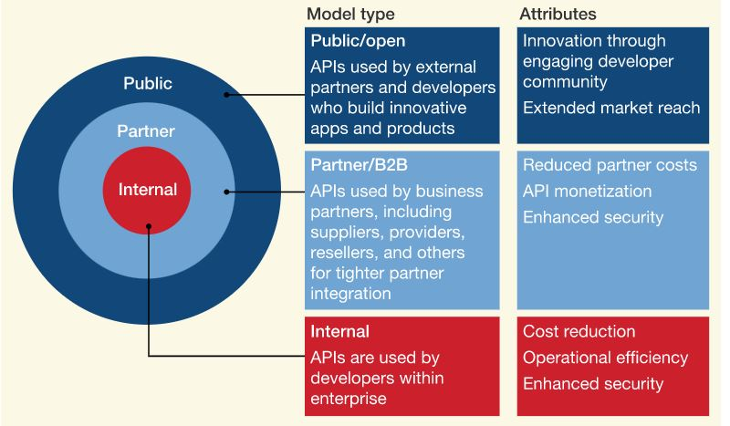
API Models
Source: https://www.mckinsey.com/industries/financial-services/our-insights/data-sharing-and-open-banking

Slide 33
Batch Applications

Slide 34
What is a Batch App?
Computation with defined start & end, and runs without end user interaction
Can be “scheduled” to run at predefined time
Can be triggered by an event or message
Inspired by batch production: a predefined set of widgets manufactured at a time
Batch Application typically involves a “job” and a “scheduler”

Slide 35
Why Batch App?
Offload computation from online systems
Efficient bulk processing of data, e.g., database updates and ETL
Bulk operations on digital images & videos, e.g., resizing, conversion, watermarking etc.
Applicable in B2B Use Cases

Slide 36
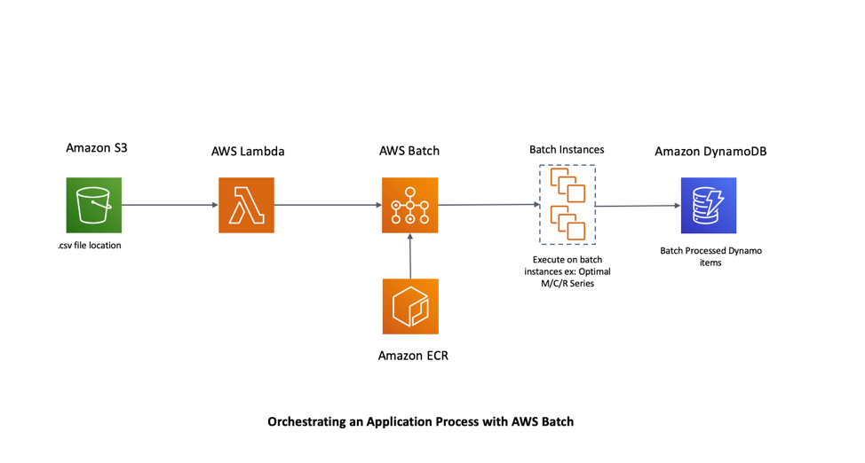
Supported in the Cloud
Source: https://aws.amazon.com/blogs/compute/orchestrating-an-application-process-with-aws-batch-using-aws-cloudformation/

Slide 37
What have we learned?
1
2
Need for Middleware & API Gateways
3
API Security Challenges & Best Practices
Enterprise Application Integration (EAI)
4
JSON Web Token
Business to Business (B2B) Computation
5
Batch Applications
6

Slide 38
References
Enterprise application integration. In Wikipedia, The Free Encyclopedia. Retrieved October 2021, from https://en.wikipedia.org/wiki/Enterprise_application_integration
Service-oriented architecture. In Wikipedia, The Free Encyclopedia. Retrieved October 2021, from
https://en.wikipedia.org/wiki/Service-oriented_architecture
JSON Web Token. In Enterprise Integration Patterns. Retrieved September 2015, from http://www.enterpriseintegrationpatterns.com/patterns/messaging/
Kumar, L., 2019. Understanding the Event-Driven Architecture. Retrieved October 2021, from: https://softobiz.com/understanding-the-event-driven-architecture/
Business-to-business. In Wikipedia, The Free Encyclopedia. Retrieved October 2021, from https://en.wikipedia.org/wiki/Business-to-business
Notes:
Here are a few references, which will help you get a deeper understanding of topics.

